Slide 1

Leeds-Sharp
Machine Learning with ML.NET and Azure
9th October 2018

Slide 2
Who am I?

Slide 3





.NET Core
3
2
.NET Core 3 expands supported workloads to include Windows Desktop, IoT & AI
.NET Core is perfectly suited for the requirements of cloud-native, cross-platform workloads
WEB
CLOUD
DESKTOP
IoT
AI
.NET CORE
.NET CORE 3
LIBRARIES
INFRASTRUCTURE
RUNTIME COMPONENTS
COMPILERS
LANGUAGES
Notes:
ANIMATED SLIDE – shows progression of entire .NET platform into .NET Core specific workloads.
Recap – assume no one knows anything about netcore
.NET Core is our cross-platform, open source implementation of .NET and is perfectly suited for requirements of cloud-native, cross-platform services. We’ve made significant investments in the core performance as well as the web stack so that you can easily take advantage of cloud patterns and scale.
.NET Core 3 will expand on the supported workloads to include IoT, AI and Windows Desktop.

Slide 4



Update .NET Framework Apps
Modernize Desktop Apps with .NET Core 3
Highly compatible updates
Install .NET Core updates per your
needs
Existing App
.NET Framework 4.8
.NET Core 3
Windows-only
Windows-only
Cross-platform
Highly-compatible, targeted improvements, like last few releases
UWP
WEB
DATA
AI/ML
WPF
ASP.NET Core
EF 6
EF Core
ML.NET
Windows Forms
.NET STANDARD
.NET Framework support unchanged (supported for life of Windows)
Side-by-side support
Self-contained EXEs
XAML Islands - WinForms & WPF apps can host UWP controls
Full access to Windows 10 APIs
FEATURES IN BOTH FXs
Notes:
.NET Framework will continue with highly-compatible targeted improvements like the last few releases and support will remain unchanged. You will be able to retarget existing apps to 4.8 and gain these improvements.
When you’re ready to move to .NET Core 3 (to take advantage of SxS install, interop between desktop app frameworks, and .NET Core performance) you can retarget and rebuild your apps to .NET Core.

Slide 5
What is machine learning?

Slide 6
Machine learning for prediction talk quality
Formal definition: -
"A computer program is said to learn from experience E with respect to some class of tasks T and performance measure P if its performance at tasks in T, as measured by P, improves with experience E.“
E = historical quantities of beer consumed and corresponding audience ratings
T = predicting talk quality
P = accuracy of the talk quality prediction

Slide 7
Types of machine learning
Two most commonly used machine learning methods: -
Supervised
the computer is presented with example inputs and their desired outputs, given by a "teacher“
goal is to learn a general rule that maps inputs to outputs
Unsupervised
no desired outputs (“labels”) are given to the computer, leaving it on its own to find structure in the input
the goal may be to discover hidden patterns or groups in the data

Slide 8
Examples tonight
Supervised
Sentiment analysis of website comments
Finding mappings of historic taxi fares
Unsupervised
Predicting the most likely group of flowers a certain flower belongs to
NOTE: We reuse algorithms; to do so in most cases is akin to writing a new database to write a website – a vast overreach of engineering

Slide 9
Machine learning best practice
Machine learning should be approached in a methodical manner, in this way we are more likely to achieve accurate, reliable and generalisable models
This is achieved by following best practice for machine learning
Best practice mostly revolves around how the data is used

Slide 10
Machine learning best practice
Data preparation
Ensure that the feature do not contain future data (aka time-travelling)
Training, validation and testing data sets
Cross validation
Think of this as using mini training and testing data sets to find a model that generalises to the problem
Validation and testing data sets
Data that the model has never seen before – simulate the future
Gives a final ‘sanity’ check of our model’s performance

Slide 11
Model training
Provide an algorithm with the training data set
The algorithm is ‘tuned’ to find the best parameters that minimise some measure of error

Slide 12
Model testing
To ensure that our model has not overfit to the training data it is imperative that we use it to predict values from unseen data
This is how we ensure that our model is generalisable and will provide reliable predictions on future data
Use a validation set and test sets

Slide 13
Validation set
The validation set is randomly chosen data from the same data that the model is trained with – but not used for training
Used to check that the trained model gives predictions that are representative of all data
Used to prevent overfitting
Gives a ‘best’ accuracy

Slide 14
Test set
The test set data should be ‘future’ data
We simulate this by selecting data from the end of the available time-frame with a gap
Use the trained model to predict for this
More realistic of the model in production
Gives a conservative estimate of the accuracy

Slide 15
Validation and test sets
Test 1
Test 2
01/01/15
04/02/17
09/06/17
21/06/17
01/11/17
13/11/17
= Training data
= Validation data
= Testing data
= Ignored data

Slide 16
Machine learning algorithms
There are many different choices of algorithm that learn the relationship from input to output in different ways
The algorithm that gave the best performance in this project is called Random Forest
Random Forest is an advanced algorithm from the ‘ensemble’ family of models

Slide 17
Random Forest algorithm
An ensemble model is one that uses multiple models to provide a single prediction
The final, single prediction will be the mean of all predictions from the multiple models
It has been found that by combing many ‘weak learners’ into a single ‘strong learner’, models that are more accurate and more reliable than any of the constituent models alone are achievable

Slide 18
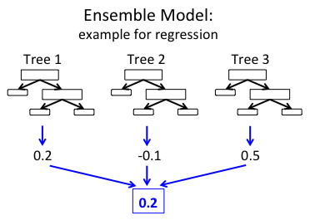
Random Forest algorithm
Random forest is an ensemble of traditional Decision Trees
Each Decision Tree learns a different relationship from the training data
When given new data each decision tree predicts a value, the mean of these values is the overall prediction

Slide 19
Model training, validation and testing
Train with cross validation to find best parameters
Assess overfitting on validation set
Retrain with best parameters on training data set
Evaluate performance on test data sets

Slide 20
How does this relate to Big Data?

Slide 21
Distributed Computing
Break a larger problem into smaller tasks
Distribute tasks around multiple computation hosts
Aggregate results into an overall result
Types of Distributed Compute
HPC – Compute Bound
Big Data – IO Bound
Big Data – Database free at scale IO over flat files

Slide 22
Azure Services for Distributed Compute
Azure Batch
Azure HDInsight
Azure Databricks
Bring your own partitioner
Azure Functions
Azure Service Fabric (Mesh)
Virtual Machines
ACS/AKS

Slide 23
Azure Services for ML

Slide 24
Various places for ML
Azure Databricks
Azure HDInsight
Azure Data Lake Analytics
Azure ML
V1
V2 with Workbench
V2 RC no Workbench
R/Python in many hosts
Functions
Batch
SQL Database
C# and dotnet hosted in many places
Typical Azure DevOps pipelines more mature for .NET

Slide 25
Azure Databricks
Databricks Spark hosted as SaaS on Azure
Focussed on collaboration between data scientists and data engineers
Powered by Apache Spark
Dev in:
Scala
Python
Spark-SQL
More?

Slide 26

Azure HDInsight
Multipurpose Big Data platform
Operates as a host and configurator for various tools
Hadoop
Hive
Hbase
Kafka
Spark
Storm

Slide 27
Revolutionising data for dotnet

Slide 28






Data Landscape
.NET
Operationalisation mandates database rectangularisation to take advantage of ADO.NET
Utilising System.IO is unstructured, our evidence is that most users handroll some form of CSV/TSV or use JSON encoding as it is a safe space.
Parquet
.NET
First stage transcoding from “something .NET can write to”
All subsequent data inspection and manipulation outside of .NET

Slide 29

Data Landscape
.NET can read operational output from ML and Big Data natively using Parquet.net
.NET
Machine Learning for .NET
Utilising System.IO is unstructured, our evidence is that most users handroll some form of CSV/TSV or use JSON encoding as it is a safe space.
Parquet
Parquet.NET
.NET
Immediately serialize .NET POCOs to Parquet
Parquet specific optimisation and inspection tools in .net

Slide 30
Introduction to ML.NET
With Example in Sentiment Analysis with Binary Classifier

Slide 31
0.6.0 Goodbye: ML.NET Pipelines
Library evolving quickly
Towards common approach in Spark/SciKit-Learn
LearningPipeline weaknesses:
Enumerable of actions not common elsewhere
Logging and State not handled
Bring in Context, Environment and lower level data tools IDataView
Not all <0.6.0 features available, so later demos are “Legacy”

Slide 32
Sentiment Analysis
By showing examples of content and a Toxic bit flag, learn that makes things Toxic
The quality of the model reflects the quality of the data
Representation
Variety
Breadth

Slide 33
Testing and Training Data
Tab Separated, two columned data set with headers.
Sentiment | SentimentText
1 | ==You're cool== You seem like a really cool guy... *bursts out laughing at sarcasm*.
0 | I just want to point something out (and I'm in no way a supporter of the strange old git), but he is referred to as Dear Leader, and his father was referred to as Great Leader.
1 | ==RUDE== Dude, you are rude upload that carl picture back, or else.
0 | " : I know you listed your English as on the ""level 2"", but don't worry, you seem to be doing nicely otherwise, judging by the same page - so don't be taken aback. I just wanted to know if you were aware of what you wrote, and think it's an interesting case. : I would write that sentence simply as ""Theoretically I am an altruist, but only by word, not by my actions."". : PS. You can reply to me on this same page, as I have it on my watchlist. "

Slide 34
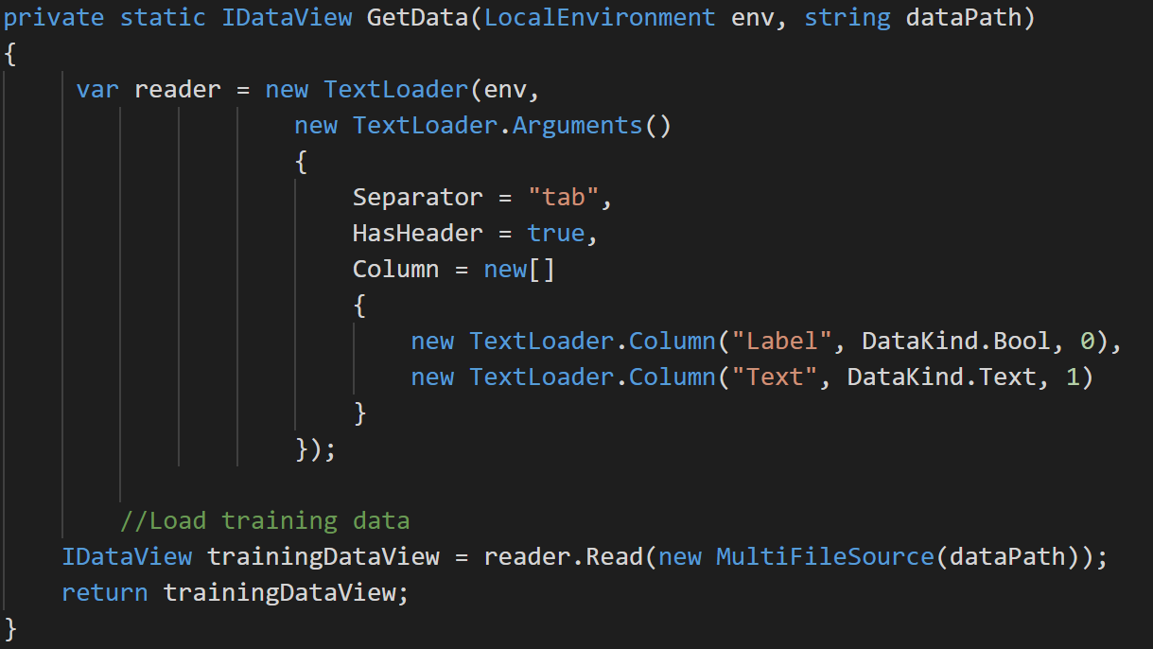

Slide 35
Simple to build classifier
var pipeline = new TextTransform(env, "Text", "Features") .Append(new LinearClassificationTrainer(env, new LinearClassificationTrainer.Arguments(),
"Features",
"Label"));
var model = pipeline.Fit(trainingData);

Slide 36
Evaluation of Models
PredictionModel quality metrics evaluation
------------------------------------------
Accuracy: 94.44%
Auc: 98.77%
F1Score: 94.74%
IDataView testData = GetData(env, _testDataPath);
var predictions = model.Transform(testData);
var binClassificationCtx = new BinaryClassificationContext(env);
var metrics = binClassificationCtx.Evaluate(predictions, "Label");

Slide 37
Demo

Slide 38
Data
Loading and Transforming data in a pipeline

Slide 39
Supported Types
Text (CSV/TSV)
Parquet
Binary
IEnumerable<Τ>
File sets

Slide 40
The problem with flat files
With no database or storage engine Data is written arbitrarily to disc
Format errors
Caused by bug
Caused by error
Inefficiencies
Compression an afterthought
GZIP splittable problem

Slide 41
More problems with flat files
Access errors
Mutability
Variablity between files in a fileset
Naivety
Just because brute force scanning is possible doesn’t mean it’s optimal
Predicate Push-Down
Partitioning

Slide 42
Parquet
Apache Parque is a file format, primarily driven from Hadoop Ecosystem, particularly loved by Spark
Columnar format
Block
File
Row Group
Column Chunk
Page

Slide 43
Designed for Data(!)
Schemas consistent through file
Held at the end so can be quickly seeked
By Convention: WRITE ONCE
Parallelism:
Partition workload by File or Row Group
Read data by column chunk
Compress per Page

Slide 44
Parquet.NET
Until recently no approach available to .NET
Leading to System.IO to write arbitrary data and then requiring data engineering to sort the data out
Libraries for cpp can be used
Implementation by G-Research called ParquetSharp uses Pinvoke
A full .NET Core implementation is Parquet.NET
https://github.com/elastacloud/parquet-dotnet

Slide 45
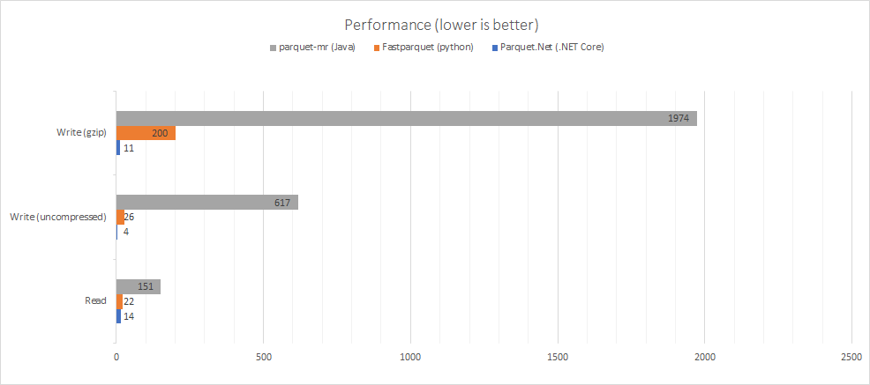

Slide 46
Parq!
End to end tooling for .NET devs on a platform they’re familiar with.
Uses dotnet global tooling

Slide 47
Futures
Arrow.NET

Slide 48
Demo of Parquet.NET

Slide 49
Regression analysis

Slide 50
What is regression?
Supervised Machine Learning
Features go to a Label
Label is a “real value” not a categorical like in classification
Regression algorithms generate weights for features

Slide 51
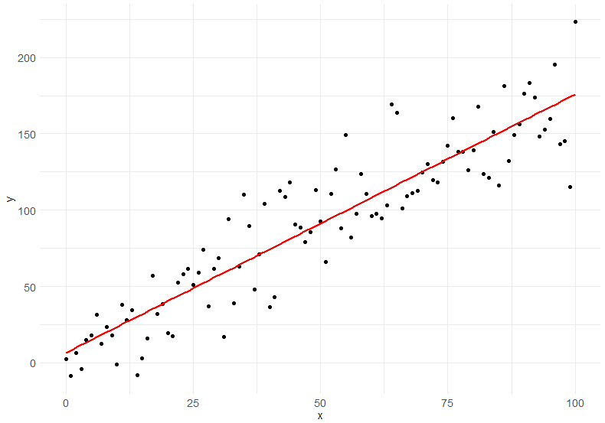

Slide 52
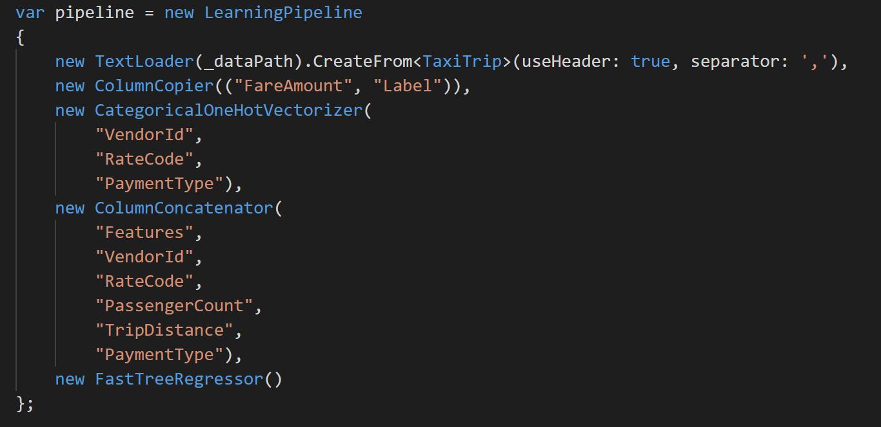

Slide 53
Evaluation with RMS and r²
Rms = 3.30299146626885
RSquared = 0.885729301000846
Predicted fare: 31.14972, actual fare: 29.5
Run through of r2 & RMSE

Slide 54
Clustering
Example of the Iris petal detector

Slide 55
What is Clustering
Used to generate groups or clusters of similarities
Identify relationships that are not evident to humans
Examples may be:
Who is a VIP customer?
Who is cheating in a game?
How many people are likely to drop out of class?
Which components in manufacturing are likely to fail?

Slide 56
Operationalization
Loading and not Training

Slide 57
Time Series

Slide 58
Interoperability
Loading trained models from other frameworks

Slide 59
Revisiting Skills reuse

Slide 60
Summary

Slide 61





Unified Cloud Data Environment
Suppliers
Excel
Landing
Staging
Enriched
Input Files
XML
Excel
Parquet
Parquet
Other
XML
Validated once and for all, optimised for processing
Results of machine learning experiments
Ecosystem Participants
Other
A true copy of the input data, used to trace linage and rebuild data
Operationalised
Any combination of modern data platform to support visualisations and operational systems
Stream

Slide 62
The business of ML

Slide 63
The questions to answer
Opportunity discovery
What can we do?
Adoption
How do I get my company to use this?
Sustainability
How do we control costs and/or build a viable price point?
Measurement
How do we know it’s generating value?
Build
Use
Profit

Slide 64
The end goals
Providing better customer service and experience
Better products
Self-healing and self-improving
Improving operational processes and resource consumption
Faster Time to Market
Lighter Bill of Materials
Stronger Supply Chain
New business models
Insights from data
Different pricing models

Slide 65
Mental Models
Dive deeper into strategic modelling with these mental models

Slide 66
Mental Models
In order to envision the transformation possibilities, adopt the following mental models.
AI is an extremely focussed entry level clerical assistant
AI is exceptionally reactive
AI is auditable, repeatable, improvable
AI is resistant of external bias

Slide 67
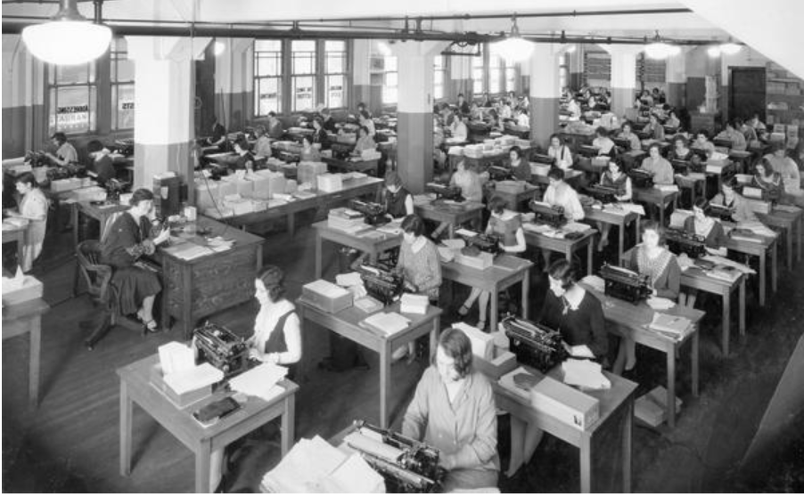
One Million Clerical Workers What is achievable with a million trained office workers?

Slide 68
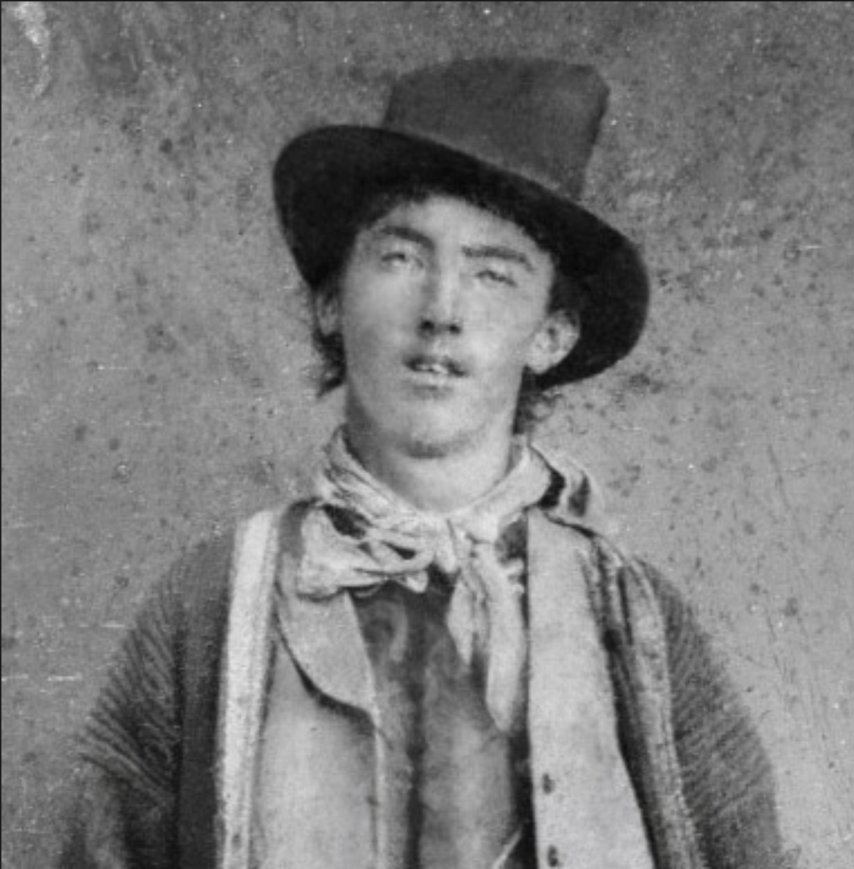
Billy the Kid Reaction Times What if all workers can react and form a course of action in 1 millisecond?

Slide 69
Auditable Actions What if all actions and their impact were measurable and qualified?
Great companies have high cultures of accountability, it comes with this culture of criticism […], and I think our culture is strong on that.
Steve Ballmer

Slide 70
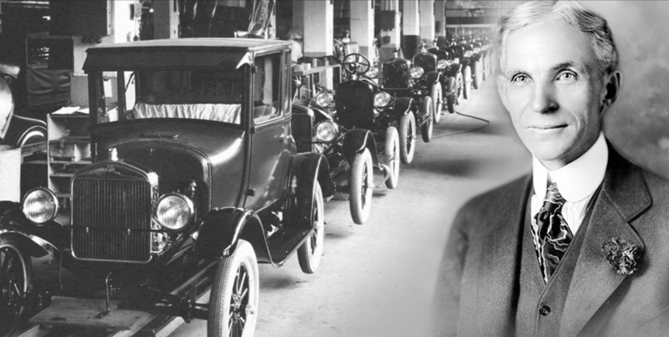
Cement the views of the Founders What if the decision making process of the hyper-successful founders was cemented and eternally referenceable? Resistant to the distractions of hype and false promises.

Slide 71
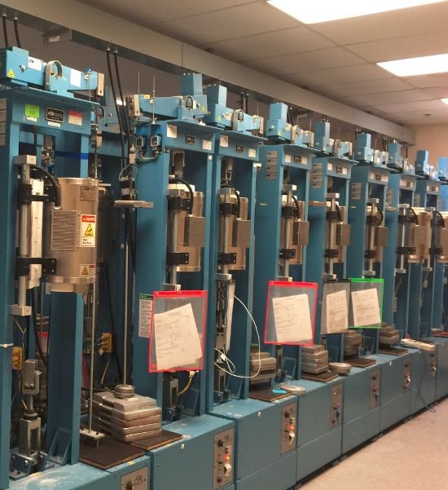
All tools are Smart Tools What if every tool used by a business was as smart as a person. A forklift could tell you the context of a crate was the wrong weight. A machine could tell you it was feeling unwell. A room could tell you someone had left a dangerous tool in an unsafe state.

Slide 72
Regarding Maintenance Contracts

Slide 73
JIT Service Regimes
Migrate from manufacturer led maintenance cycles to just-in-time
Use data to establish mean time to failure
Conditional maintenance

Slide 74

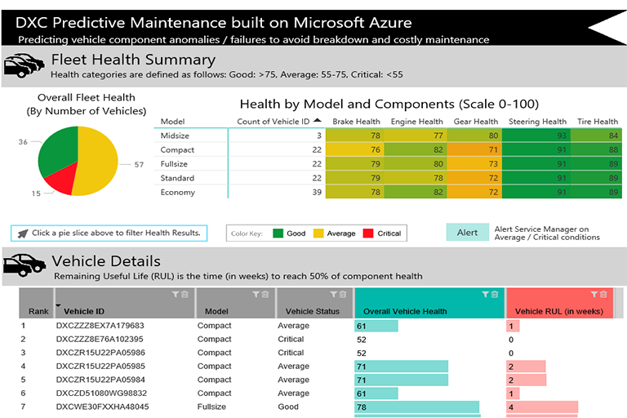
Alarm
- Predictions through AI become an integral part of business reporting
~ 1 minute telemetry
AzureML
through dedicated cloud gateway
- Machine Learning used in real-time with “Anomaly Detection” which enables history to be assessed and false positive spikes in behaviour to be discarded
- Model retraining can occur to help understand acceptable lowering of efficiency as equipment degrades over time within acceptable parameters
Reporting

Slide 75
Supplier efficiency
Use data to judge the reliability of assets
Track fault recurrence and resolution speeds
Contract with SLAs around reducing outages

Slide 76
Warehouse and Inventory Management

Slide 77
JIT Warehousing
Regarding Parts
JIT Maintenance leads to JIT Warehousing
Regarding Fuel
Integrated Data streams including ERP and CRM
Manage the supply chain and keep the right stock level

Slide 78

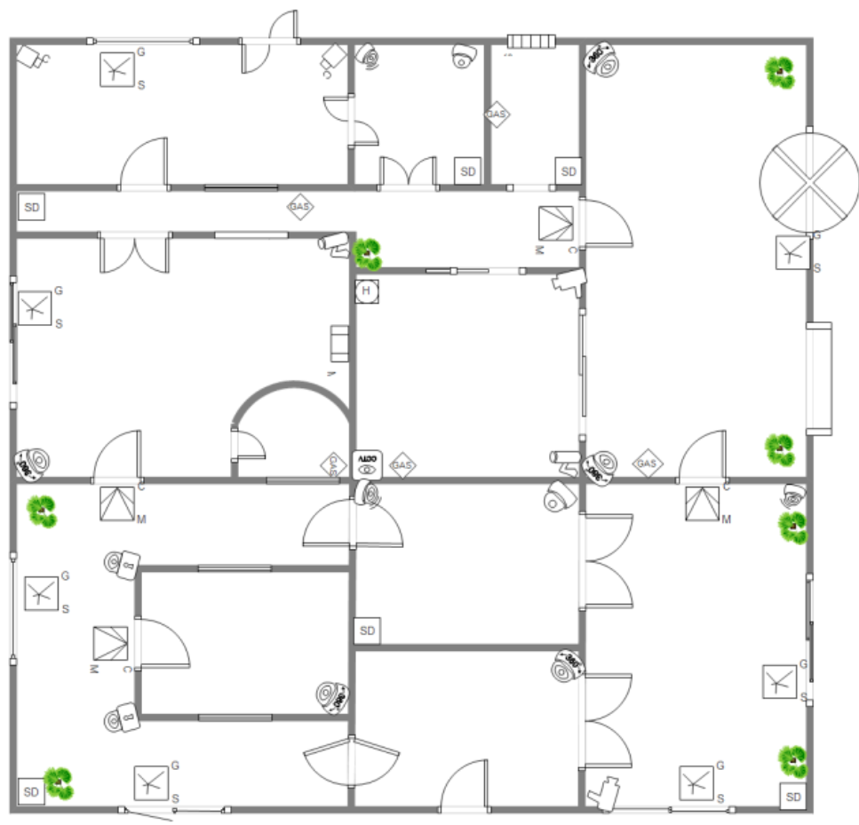

G4S Data Science Programme
G4S plc is a British multinational security services company and operates an integrated security business in more than 90 countries across the globe.
They aim to differentiate G4S by providing industry leading security solutions that are innovative, reliable and efficient.
Aim: Predict anomalous card activity in monitored buildings

Slide 79
Energy

Slide 80
Market Dynamics
End of feed in tariffs in Solar
Solar generators need to balance
Leading to more active trading of Solar
Exacerbating market impact of solar peak
Continued Intermittency of generation sources
Wind and solar using hybrid sources to have zero balancing costs
Additional complexity from changing demand, from electric storage

Slide 81
Supply Side analytics

Slide 82
Balancing Technologies
Elastacloud have built a balancing simulator
Using Bids & Offers and Precursors predict System Pricing
Manage power export using hybrid technologies
Increased flow intra-settlement period to zero balance
Defines position at risk allowing for more active trading

Slide 83
Tech update

